Slide 1
WEATHER SHIFT PREDICTION
TTeam 13
Srishti Eligar : 01fe19bcs042
Ankita Mane : 01fe19bcs052
Swathi Pardeshi : 01fe19bcs060
Muskan Havaldar : 01fe19bcs007

Slide 2
Problem Statement
The goal is to predict the temperature at a particular latitude/longitude and time, given all available measurements and climate model predictions.

Slide 3
Data
Description

Slide 4
Train Data-Set
•We have 3129592 users in the training set.
•Number of Rows: 3129592
•Number of Columns: 129
•Size: 5.03 GB

Slide 5
Dev-in Data set
•We have 50000 users in the dev_in (development set1) set
•Number of Rows: 50000
•Number of Columns: 129
•Size: 81.7 MB

Slide 6
Dev_out data set
•We have 50000 users in the dev_out (development set2) set
•Number of Rows: 50000
•Number of Columns: 129
•Size: 80.2 MB

Slide 7
Attribute Description

Slide 8
Meta Data
•fact_time
•fact_latitude
•fact_longitude
•fact_temperature
•fact_cwsm_class
•climate

Slide 9
Column Specification
•Canadian Meteorological Center(CMC) model : 56 attributes
•Weather Research and Forecasting (WRF) model : 13 attributes
•Global Forecast system predictions(GFS) : 50 attributes
•topography_bathymetry
•sun_elevation
•climate_temperature
•climate_pressure

Slide 10
Data Pre-processing

Slide 11
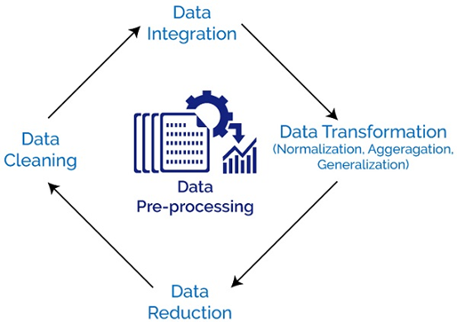
Data Pre-Processing
•Data preprocessing is a data mining technique which is used to transform the raw data in a useful and efficient format.

Slide 12
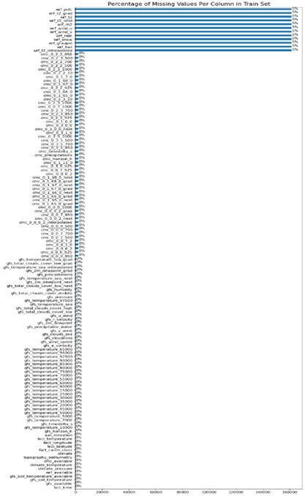
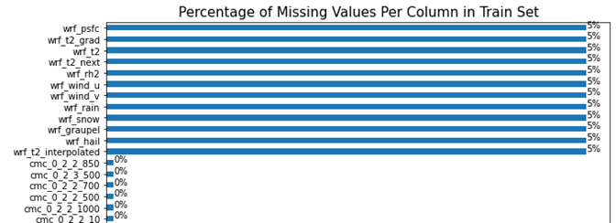
Data Pre-Processing
•Data cleaning:
Missing Values:

Slide 13
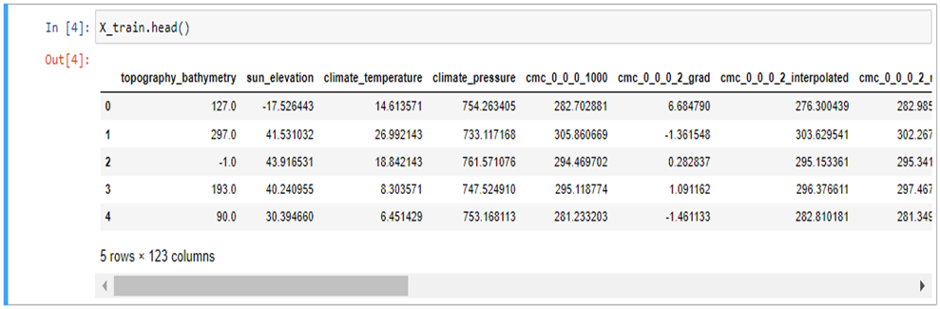
•Data Reduction :
Removing our meta-data(i.e: first 6 columns)

Slide 14
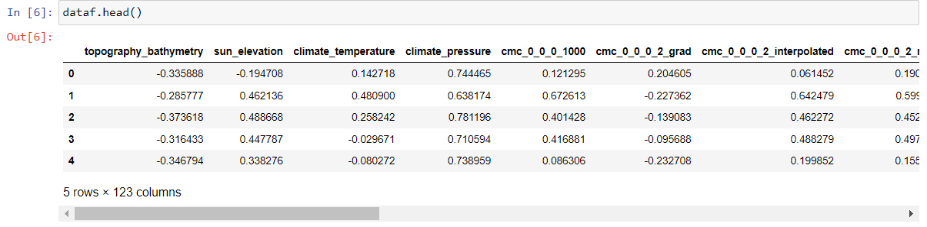
•Data transformation:
We normalized our entire data frame to a range of [-1,1]

Slide 15
Literature
Survey

Slide 16
Shifts: A Dataset of Real Distributional Shift Across Multiple Large-Scale Tasks
Work done in this paper :
Developing methods for improving robustness to distributional shift and uncertainty estimation.
What is proposed in this paper?
Shifts Dataset for evaluation of uncertainty estimates and robustness to distributional shift
Tasks:
>Weather shift prediction
>Machine Translation
>Self driving cars

Slide 17
Weather Forecasting Model Using ANN
Advantages of ANN
It gives us a predicted value which is nearly equal to the actual value.
It minimizes the error.
Models discussed:
MultiLayer Perceptron network(MLP).
Radial Basis Function Network.

Slide 18
An ANN Model Trained On Regional Data In The Prediction Of Particular Weather Conditions
The principal aim of this paper is to present the use of a regressive model based on a multilayer neural network, also called as Multilayer Perceptron.

Slide 19
THANK YOU

